Slide 1
DS MINI PROJECT
Music Playlist Manager
A Doubly Linked List Audio Engine paired with an
embedded C WinSock Web Server
C • WINSOCK2
REST / JSON API
HEAP VISUALIZER
Ria Mudhole 1262251691
Mansi Kumari 1262251426
Aditya Agarwal 1262251124
Dhani Jain 1262251217

Slide 2
PROJECT OVERVIEW
What This Project Does
A full-stack, low-level systems project that swaps high-level frameworks for a custom C engine. A Doubly Linked List manages the music library in raw memory, while a hand-built HTTP server exposes it as a REST-like JSON API — driving a modern, Spotify-style web dashboard with live pointer visualization and native MP3 streaming.
O(1)
8080
Insert, traverse
& delete nodes
Local REST
API port
2
Live
BUILT FROM FIRST PRINCIPLES
Sort engines —
Bubble & Merge
Heap pointer
visualization
Raw TCP sockets → hand-parsed HTTP → pointer-level list operations — no frameworks, no CLI prompts, just C and memory.
02 / 09

Slide 3
KEY FEATURES
What It Can Do
01
Dynamic Memory Mgmt
02
Embedded HTTP Server
03
REST JSON API
Head-and-tail DLL with O(1) insert, traverse & delete via malloc/free.
Raw WinSock2 TCP server that parses GET/POST and streams files & audio.
C functions serialize live list state into JSON for the frontend.
04
Heap Pointer Visualizer
05
Sorting & Search
06
Playback & Persistence
Real-time view of node addresses and prev/next linkages.
Multi-key reordering by title or duration — Bubble Sort & Merge Sort.
HTML5 audio streaming plus auto-sync to library.txt on disk.
03 / 09

Slide 4
SYSTEM ARCHITECTURE
Three Layers, One Pointer Chain
Browser Dashboard
index.html — HTML5 audio player · pointer map UI · REST client
HTTP / REST (JSON)
Embedded C TCP Server
web_server.c — WinSock2 · HTTP request parser · file / audio streamer
Direct pointer manipulation
Doubly Linked List Engine
dll_engine.c — Node ⇄ Node ⇄ Node pointer manipulation
04 / 09

Slide 5
CORE DATA STRUCTURE
The Doubly Linked List Engine
NULL
Prev
Data
Next
Prev
Data
Next
Prev
Data
Next
NULL
Node 1
Node 2
Node 3
1
Bubble Sort
2
Merge Sort
3
Linear Search
Simple pairwise-swap ordering by title or track duration.
Efficient divide-and-conquer sort for larger playlists.
Traverses nodes to locate a track by title on demand.
05 / 09

Slide 6
ALGORITHM CHOICES
Why We Used Them
01
Linear Search
02
Binary Search
linearSearch()
binarySearch()
USED FOR
USED FOR
Looking up a track by its title, or part of it, from the search box.
Intended for fast title lookups once the playlist has been sorted.
WHY
WHY
The playlist is not kept sorted, and linked-list nodes can only be reached in order. A head-to-tail scan works on any list with no preparation.
It halves the search range each step, so sorted data needs far fewer comparisons. Routed to linearSearch() for now: linked lists have no direct middle access.
03
Bubble Sort
04
Merge Sort
bubbleSort()
mergeSort()
USED FOR
USED FOR
Reordering the playlist by title (A–Z) or by track duration.
Sorting larger playlists by title or duration.
WHY
WHY
Simple, sorts in place with O(1) extra memory, and stops early if the list is already ordered. A good fit for small playlists and easy to show as pointer swaps.
Guaranteed O(n log n) and a natural match for linked lists, since it splits and relinks nodes without random access. For now it delegates to bubbleSort().
07 / 09

Slide 7
COMPLEXITY ANALYSIS
Time & Space Complexity
ALGORITHM
BEST
AVERAGE
WORST
SPACE
AS IMPLEMENTED
Linear Search
O(1)
O(n)
O(n)
O(1)
Scans head → tail. strstr() substring check adds O(m) per node, so O(n·m) in characters.
linearSearch()
Binary Search
O(1)
O(n)
O(n)
O(1)
Only calls linearSearch(), so it is linear. A true binary search can’t reach O(log n) on a linked list.
binarySearch()
Bubble Sort
O(n)
O(n²)
O(n²)
O(1)
Swapped flag exits early on sorted input. Swaps data with strcpy, not pointer relinking.
bubbleSort()
Merge Sort
O(n)
O(n²)
O(n²)
O(1)
Currently just calls bubbleSort(). A real list merge sort would be O(n log n), O(log n) stack.
mergeSort()
Takeaway: both “fast” algorithms are placeholders. Implementing true Merge Sort would cut sorting from O(n²) to O(n log n).
06 / 09

Slide 8
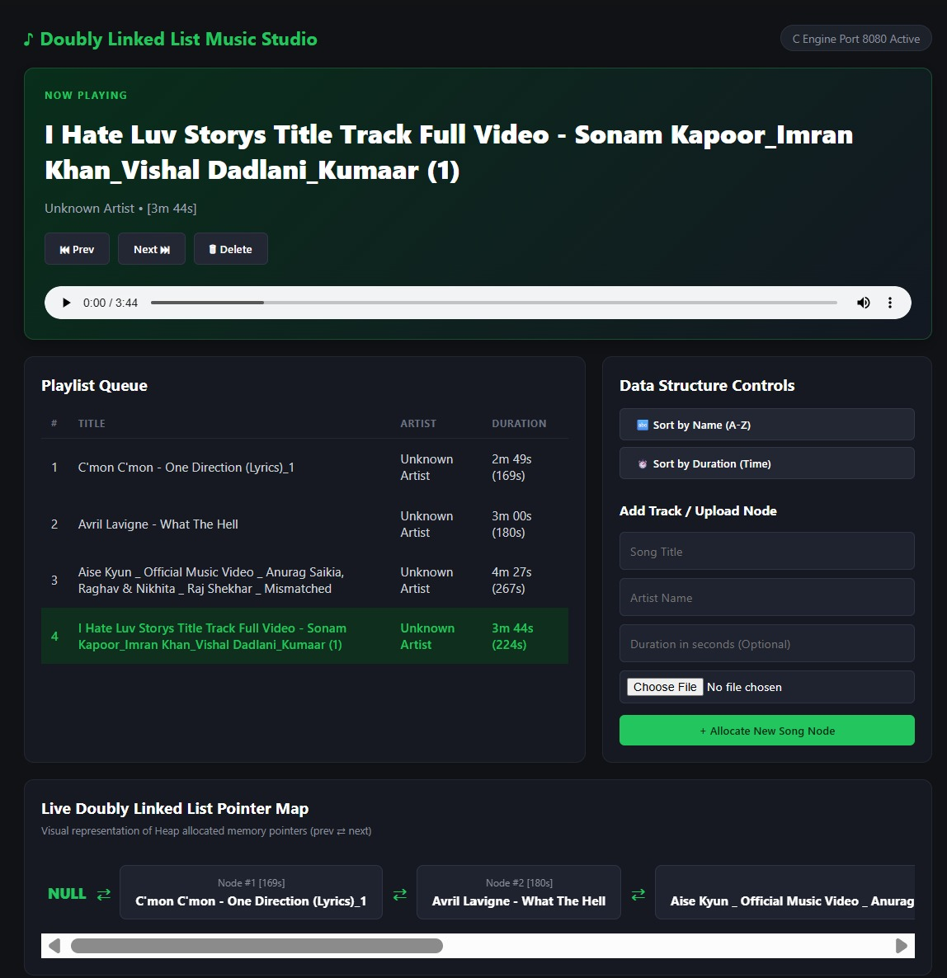
APPLICATION PREVIEW
The Live Dashboard
01
Now Playing
HTML5 audio player with Prev, Next and Delete wired to the list pointers.
02
Playlist Queue
Live table of title, artist and duration, with the current node highlighted.
03
Data Structure Controls
Sort by name or duration, and add or upload a new song node.
04
Pointer Map
Heap-allocated nodes drawn with their prev ⇄ next links, starting from NULL.
08 / 09

